Slide 1
An Object-oriented Approach to Role-playing Game Battle Systems
Evan Hildreth
High School
Mentor: Lee W
Advisor: Wendy P

Slide 2
Introduction
(getting started)

Slide 3
Video Games?
Video games large part of society
More people want to make their own games
How easy or hard is it to build a game from scratch?

Slide 4
What Am I Doing?
Prove object-oriented methods can be used to build a battle system
Research and analyze different RPGs
Build my own battle system

Slide 5
Why This?
Enjoy video games
Enjoy programming
Want to know how involved a game is
Pure satisfaction

Slide 6
Review of Literature
(useful information)

Slide 7
Different Languages
BASIC
  Beginner’s All-Purpose Symbolic Instruction Code
Pascal, C
  First structured languages
C++, Objective-C, Java
  Object oriented programming
Perl
Pathologically Eclectic Rubbish Lister
Practical Extraction and Report Language

Slide 8
Object-oriented Programming
First developed in 1960s
Groups different parts of programs into “objects”
  Each object has data and methods
  Some parts of objects are hidden from the rest of the program
  Objects can inherit functionality from other, more abstract objects

Slide 9
An Example…
Calls “Desired Food” Method
Customer
Server
Calls “Cook Food” Method
Employee
Cook
Inherit “Receive Payment” Method

Slide 10
Portability
Ability to run a program on two different types of computers
Complex programs must be re-written
Simple programs must be re-compiled
Java and Perl can run anywhere

Slide 11
Video Games
“A game is a closed, formal system that subjectively represents a subset of reality.”
– Chris Crawford
Consoles are game-only computers
Games must be
  Error-free
  Able to run on multiple machines
  Fun!
Developers love games as much as the players that play them.

Slide 12
Role-Playing Games (RPGs)
Player follows a character that improves as the game progresses
Began with Dungeons and Dragons
Modern games combine from D&D and adventure games
  In adventure games, a character is guided through a world by the player

Slide 13
The Battle System
Portion of the game that simulates a battle
Focal point of many modern RPGs:
  without a good battle system, gameplay suffers

Slide 14
Methodology
(what I did)

Slide 15
The Process
Ask other gamers for favorite RPGs
  Turn-based battle systems only
Analyze based on
  Character improvement
  Weapon equipping
  Standard and special attacks
  Status changes

Slide 16
Games Reviewed
Lunar Legend
Chrono Trigger
Final Fantasy Tactics
Final Fantasy VII
Final Fantasy VIII

Slide 17
Presentation of Findings
(what I learned)

Slide 18
First, the Basics
Performance statistics
Health Points (HP)
Experience Points (EXP)
Improving weapons
Special Attacks and Magic Points
Poison, sleep, confusion, etc…

Slide 19
Lunar Legend
Very basic game
Easy to pick up
Simplicity inhibited customization

Slide 20
Lunar Legend
Character creation/improvement:
Weapon equipping:
Standard attacks:
Special attacks:
Status changes:
Overall:
4
4
3
5
3
3.8

Slide 21
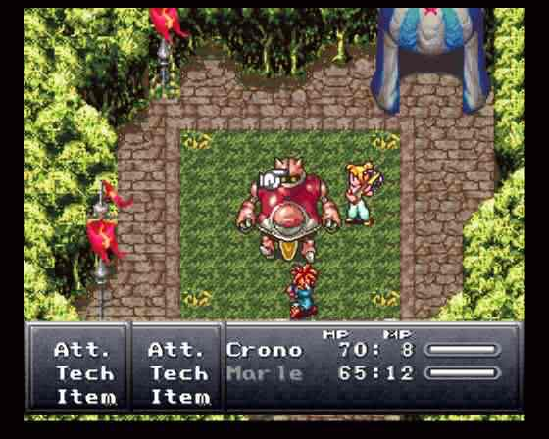
Chrono Trigger
Active time battle gives fast players / characters an edge
Allows combo attacks

Slide 22
Chrono Trigger
Character creation/improvement:
Weapon equipping:
Standard attacks:
Special attacks:
Status changes:
Overall:
3
3
3
5
3
3.4

Slide 23
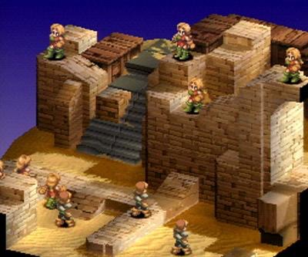
Final Fantasy Tactics
Extremely involved
Job system allows for almost infinite customization

Slide 24
Final Fantasy Tactics
Character creation/improvement:
Weapon equipping:
Standard attacks:
Special attacks:
Status changes:
Overall:
5
4
4
4
4
4.2

Slide 25
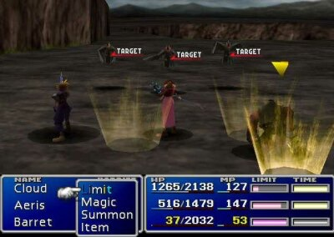
Final Fantasy VII
Materia easy to understand
Requires player to enhance multiple characters at once

Slide 26
Final Fantasy VII
Character creation/improvement:
Weapon equipping:
Standard attacks:
Special attacks:
Status changes:
Overall:
3
4
4
2
3
3.2

Slide 27
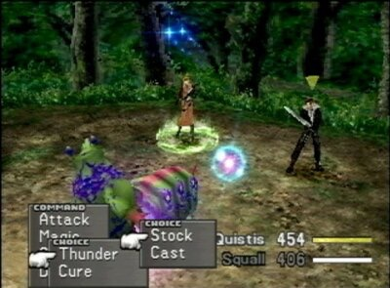
Final Fantasy VIII
Junction System powerful, but complex
Does not use MP
Limit Breaks

Slide 28
Final Fantasy VIII
Character creation/improvement:
Weapon equipping:
Standard attacks:
Special attacks:
Status changes:
Overall:
3
4
5
2
4
3.6

Slide 29
Conclusions
(what’s it mean?)

Slide 30
So… Does It Work?
Yes! It is possible for me to make a battle system with an object-oriented language…
But just barely.

Slide 31
Shortcomings
No graphics
Sloppy methods
No artificial intelligence
Not complete

Slide 32
But It’s Not All Bad
It works!!!
Can have opposing teams with multiple characters each
Learn new attacks with time
Can summon monsters
Adrenaline rush!

Slide 33
What Have I Learned?
Effort needed for video game
Intricacy of RPGs
One programmer can only accomplish so much
Good and bad object-oriented methods
Final product designed for entertainment

Slide 34
Acknowledgements
Thank you, thank you very much.

